Slide 1
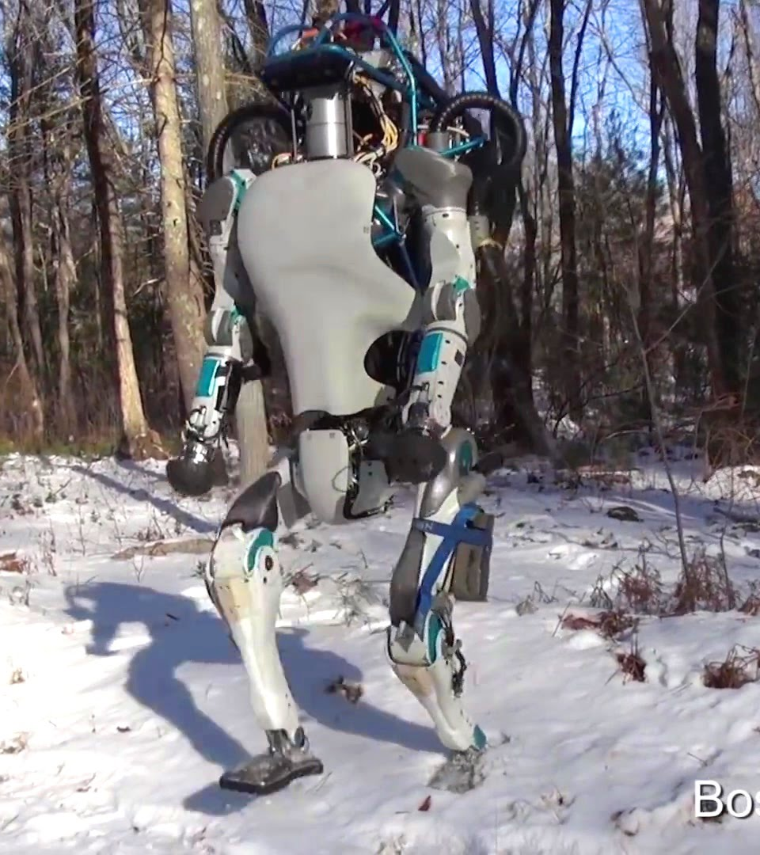
Project Atlas
Jason Liu
Hiranya Kamdar

Slide 2
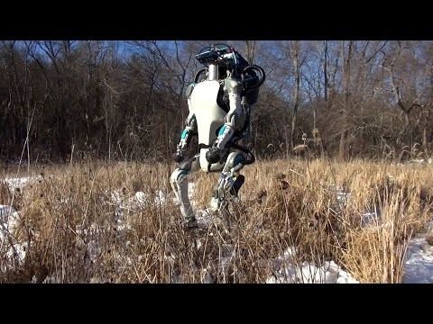

Slide 3
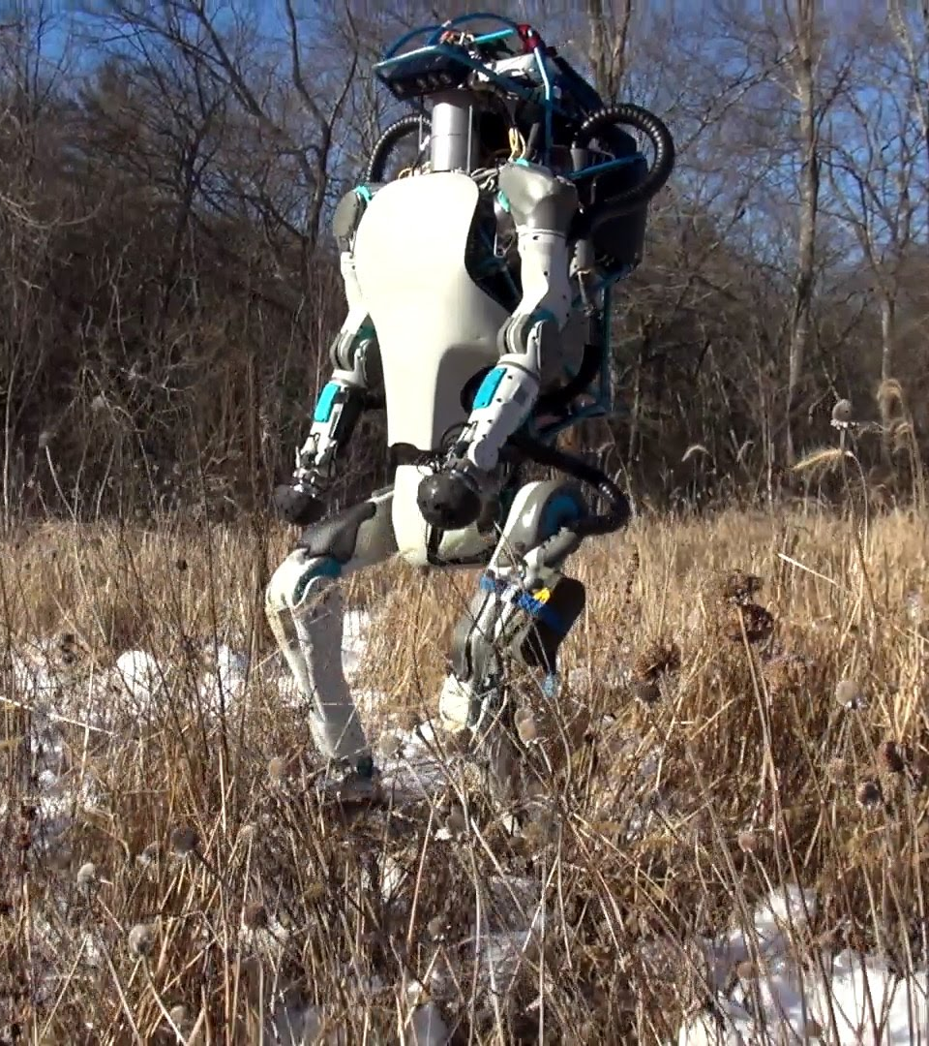
Features
6 feet tall, 150 kg
High mobility and balance
Able to walk or climb on rough terrain
Equipped with laser rangefinder and stereo cameras
Controlled by onboard computers
Fine motor skills
Limbs have 28 degrees of freedom

Slide 4
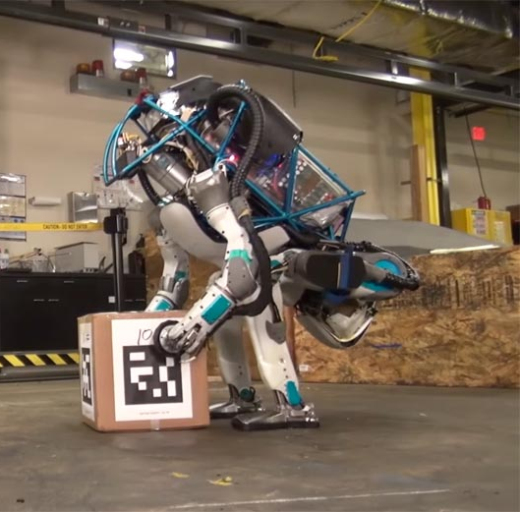
Purpose of Atlas
Created by Boston Dynamics as part of 2013 DARPA Challenge
Can be used to complete lift, carry, and manipulate environment
Ideal for search and rescue operations

Slide 5
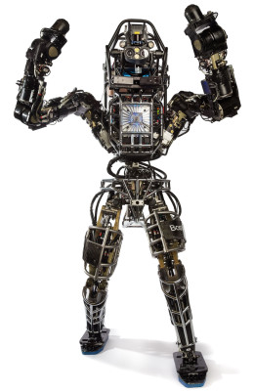
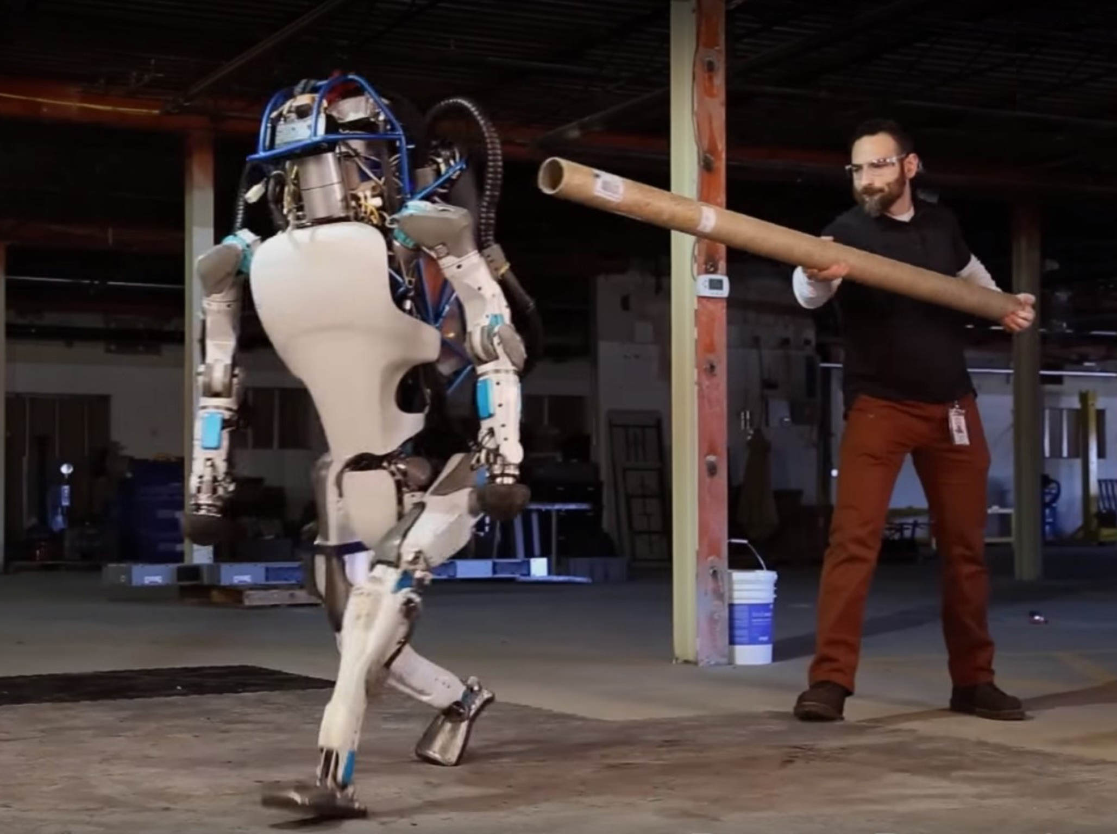
State of project
First version completed in 2013
Newer version (the one shown) completed in 2016
Plans to improve AI for balance and functionality

Slide 6
Source/References
https://www.youtube.com/watch?v=rVlhMGQgDkY
http://www.bostondynamics.com/robot_Atlas.html

